Slide 1

Enhancing Happiness through Financial Well-being

Slide 2
Team : Code Troopers
Team Leader
Joshi Divyang Bharatbhai
Team-Members:
Dhokai Apoorva Ashokbhai
Agrawal Nandini Pavankumar
Shah Kinjal Amitbhai
Summary :
1st Runner-Up At HackHaven 1.0 National level Hackathon , Mumbai
Shortlisted for the National level Hackathon Code Kshetra , Delhi
Shortlisted for the National level Hackathon RNS Hack, Bengaluru.

Slide 3
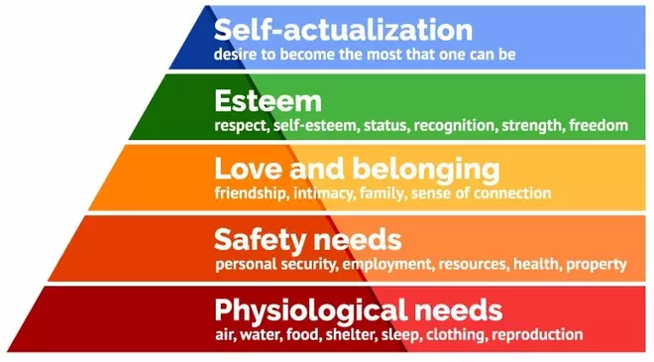
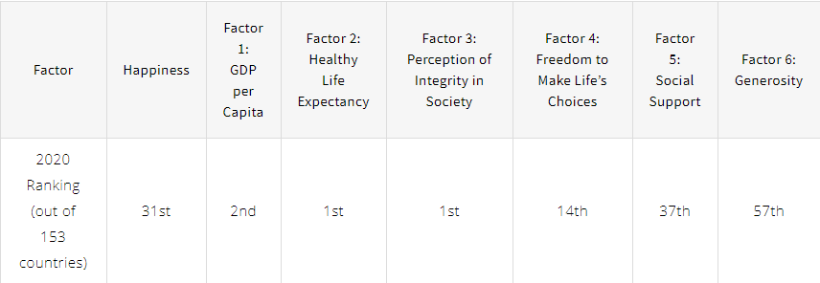
BACKGROUND
Singapore is only ranked 31st on the happiness index
Ranked only 14th in freedom to make life choices
Freedom to make life choices linked to financial well-being

Slide 4
Significance of problem
Poor financial well-being has adverse impacts on one’s physical, mental and social health
Singapore rank on OCBC Financial Wellness Index dropped to 61
Poor financial well-being may lead to decreased happiness level
Seek to identify people with poor financial well-being to increase their happiness level
Notes:
Studies have shown that poor financial well-being can adversely impact one’s physical, mental and social health which can lead to other negative impacts such as poorer job performance, lower productivity and absenteeism, all of which could lead to unhappiness. The OCBC Financial Wellness Index, which is a measurement of Singapore’s financial wellness, has dropped from 63 in 2019 to 61 in 2020, especially due to COVID-19 pandemic. With the current pandemic, more people are likely to have poor financial well-being which may result in decreased happiness level.
Given that Singapore’s main resource is its population, the government aims to bridge the income gap to ensure that all Singaporeans are given equal opportunities. The improvement of financial well-being will not only improve these people’s happiness, but also their productivity and health.
Therefore, identifying these people with poor financial well-being will allow the government to more efficiently allocate resources such as money, time and effort, towards those who require financial aid the most to achieve greater happiness. Thus, we need a systematic approach to identify these people through machine learning and artificial intelligence techniques.

Slide 5
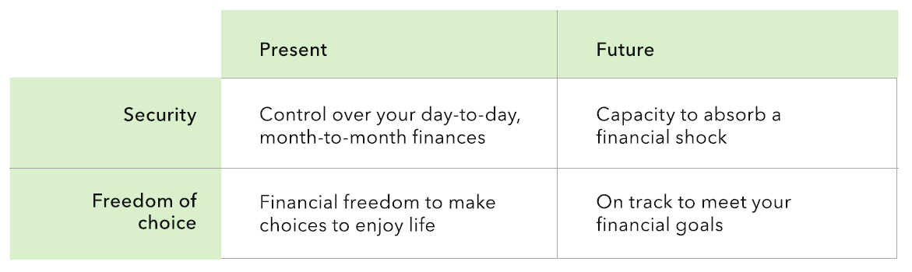
FINANCIAL WELL-BEING AND HAPPINESS
Financial well-being used as a proxy for happiness
Notes:
Overall happiness is a subjective measure that is affected by a myriad of factors, thus it would be unrealistic to tackle the whole nationwide population of unhappiness. This is why we have decided to use financial well-being as a proxy for happiness as this would mean that our target group of people’s level of happiness can be partially fulfilled by financial aid.

Slide 6




problem
Effectiveness
Reliability
Efficiency
Cost
Notes:
As we dive in deeper in identifying people who do not have financial freedom and are hence unhappy, there are the smaller problems in the current approach in terms of its effectiveness, reliability, efficiency and cost

Slide 7
Problem Statement
Despite Singapore's high GDP per capita and strong life expectancy, we rank only 31st in the World Happiness Report 2020.
Financial well-being, crucial for making life choices, is a key area needing improvement. In this hackathon, we'll leverage data analytics and machine learning to identify individuals struggling financially.
By addressing their financial well-being, we aim to enhance overall happiness in Singapore.
Let's explore our innovative approach to achieving this goal :

Slide 8

01
DATA preparation and understanding

Slide 9

Dataset Description
Survey conducted by the Consumer Financial Protection Bureau (CFPB) in 2015 .
Consists of 217 columns and 6395 rows
The y-variable, “FWBscore” is a discrete integer that indicates a person’s financial well-being on a scale of 0-100
Notes:
Today, government agencies have access to a great deal of personal data (both financial and non-financial data) of its citizens, such as phone and traffic records, health records (including genetic records), spending habits, water and electricity consumption, and even online browsing activities.
In Singapore, citizens receive financial aid from various Ministries (MSF, MOM, MOE) according to their per capita income as well as housing type. Yet, we know that financial well-being is unable to be captured fully through basic financial measures such as income or housing. This grey area requires a more sophisticated solution through a data-driven approach.
Using machine learning and artificial intelligence techniques, we aim to leverage on data analytics to sieve through the wide array of personal data that the government collects in order to aggregate a better and more holistic judgement of a person’s financial well-being and hence extend financial help to those struggling to obtain financial well-being and happiness.

Slide 10

Dataset Description
The “FWBscore” scale was determined via extensive research and accurately measures a person’s financial well-being according to four key elements
Control over day-to-day finances
Capacity to absorb financial shock
Financial freedom to make choices to enjoy life
Being on track to meet financial goals.
The result was a 10 question scale-based scoring system that accorded each person in the dataset a holistic and comprehensive indicator of their financial well-being.
Additionally, indirect questions such as financial knowledge, education level, income and employment, family history, financial habits, demographic information were also asked in the survey.
Notes:
Today, government agencies have access to a great deal of personal data (both financial and non-financial data) of its citizens, such as phone and traffic records, health records (including genetic records), spending habits, water and electricity consumption, and even online browsing activities.
In Singapore, citizens receive financial aid from various Ministries (MSF, MOM, MOE) according to their per capita income as well as housing type. Yet, we know that financial well-being is unable to be captured fully through basic financial measures such as income or housing. This grey area requires a more sophisticated solution through a data-driven approach.
Using machine learning and artificial intelligence techniques, we aim to leverage on data analytics to sieve through the wide array of personal data that the government collects in order to aggregate a better and more holistic judgement of a person’s financial well-being and hence extend financial help to those struggling to obtain financial well-being and happiness.

Slide 11
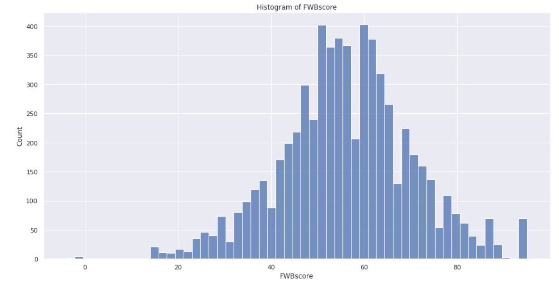
Data Exploration
The original distribution of FWBscore is roughly normally distributed with values ranging from 14-95, mean of 56 and standard deviation of 14.
“-4” indicates that the respondent’s answer was not written to the database.
“-1” indicates that the respondent refused to have the score calculated.
Notes:
Today, government agencies have access to a great deal of personal data (both financial and non-financial data) of its citizens, such as phone and traffic records, health records (including genetic records), spending habits, water and electricity consumption, and even online browsing activities.
In Singapore, citizens receive financial aid from various Ministries (MSF, MOM, MOE) according to their per capita income as well as housing type. Yet, we know that financial well-being is unable to be captured fully through basic financial measures such as income or housing. This grey area requires a more sophisticated solution through a data-driven approach.
Using machine learning and artificial intelligence techniques, we aim to leverage on data analytics to sieve through the wide array of personal data that the government collects in order to aggregate a better and more holistic judgement of a person’s financial well-being and hence extend financial help to those struggling to obtain financial well-being and happiness.

Slide 12
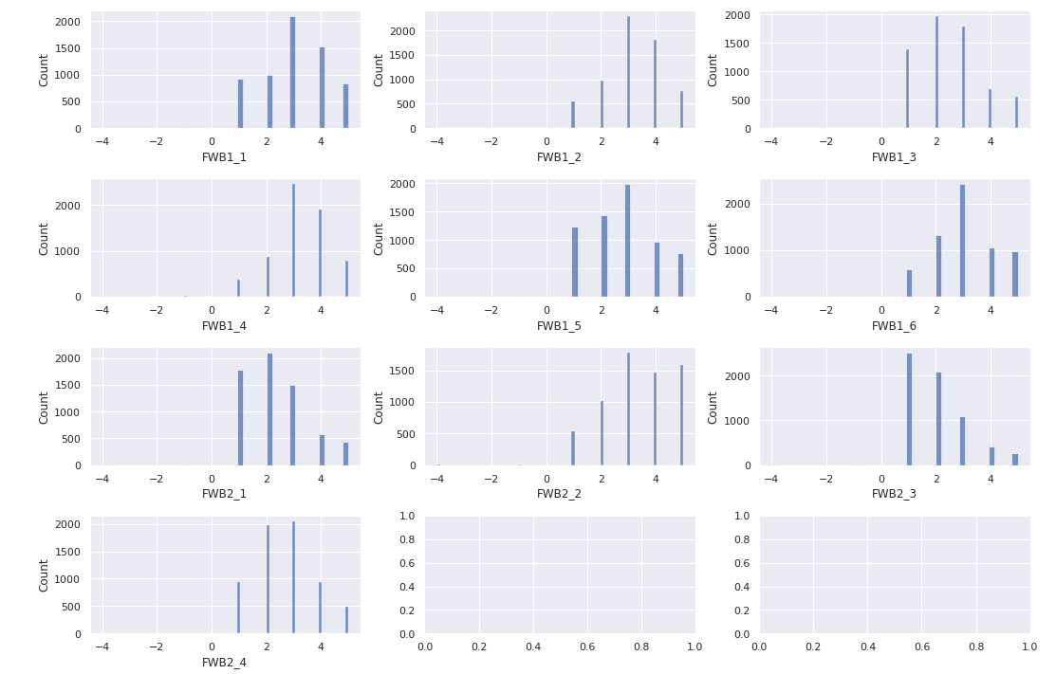
Data Exploration
Other features are roughly normally distributed with not much skew. The overall sentiment is that the respondents are quite optimistic about their own finances in terms of security and freedom of choice for present and future. However, the FWBscore's normal distribution would slightly disagree with the respondents' optimism
Notes:
Today, government agencies have access to a great deal of personal data (both financial and non-financial data) of its citizens, such as phone and traffic records, health records (including genetic records), spending habits, water and electricity consumption, and even online browsing activities.
In Singapore, citizens receive financial aid from various Ministries (MSF, MOM, MOE) according to their per capita income as well as housing type. Yet, we know that financial well-being is unable to be captured fully through basic financial measures such as income or housing. This grey area requires a more sophisticated solution through a data-driven approach.
Using machine learning and artificial intelligence techniques, we aim to leverage on data analytics to sieve through the wide array of personal data that the government collects in order to aggregate a better and more holistic judgement of a person’s financial well-being and hence extend financial help to those struggling to obtain financial well-being and happiness.

Slide 13

Data Preprocessing (data cleaning)
Summarizing, we removed 5 rows and 66 columns to produce a final dataset with 6389 rows and 151 columns
Pre-cleaned by CFPB
No missing values
No duplicates
Notes:
Today, government agencies have access to a great deal of personal data (both financial and non-financial data) of its citizens, such as phone and traffic records, health records (including genetic records), spending habits, water and electricity consumption, and even online browsing activities.
In Singapore, citizens receive financial aid from various Ministries (MSF, MOM, MOE) according to their per capita income as well as housing type. Yet, we know that financial well-being is unable to be captured fully through basic financial measures such as income or housing. This grey area requires a more sophisticated solution through a data-driven approach.
Using machine learning and artificial intelligence techniques, we aim to leverage on data analytics to sieve through the wide array of personal data that the government collects in order to aggregate a better and more holistic judgement of a person’s financial well-being and hence extend financial help to those struggling to obtain financial well-being and happiness.

Slide 14
APPROACH
Government have access to citizens personal data (both financial and non-financial data)
In Singapore, citizens receive financial aid from various Ministries according to their per capita income and housing type
However, financial well-being is unable to be captured fully through financial measures
Thus this grey area needs a more sophisticated solution through a data-driven approach
Leverage on data analytics to sieve through the wide array of personal data that the government collects
Aggregate a better and more holistic judgement of a person’s financial well-being
Extend financial help to throes struggling to obtain financial well-being and happiness

Slide 15
Choice of machine learning algorithms
Type of Algorithms |  | Chosen Algorithms
Generalized Linear Model |  | 1) Logistic Regression
Tree-based | Single model | 2) Decision Tree Classifier
 | Ensemble | 3) Random Forest Classifier
 |  | 4) XGBoost Classifier
Kernel-based |  | 5) Support Vector Classifier
Naive Bayes |  | 6) Bernoulli Naive Bayes Classifier
Neural Network-based |  | 7) Artificial Neural Network

Slide 16

Data Preprocessing (data cleaning)
All columns will be converted to categorical data type.
Except
The unique primary key “PUF_ID” will remain as integer data type.
The discrete score columns “FWBscore”, “FSscore”, “LMscore” will also remain as integer data types.
The float score columns “KHscore”, “finalwt” will remain as float data type.
Removal of rows with negative FWBscore
Notes:
Today, government agencies have access to a great deal of personal data (both financial and non-financial data) of its citizens, such as phone and traffic records, health records (including genetic records), spending habits, water and electricity consumption, and even online browsing activities.
In Singapore, citizens receive financial aid from various Ministries (MSF, MOM, MOE) according to their per capita income as well as housing type. Yet, we know that financial well-being is unable to be captured fully through basic financial measures such as income or housing. This grey area requires a more sophisticated solution through a data-driven approach.
Using machine learning and artificial intelligence techniques, we aim to leverage on data analytics to sieve through the wide array of personal data that the government collects in order to aggregate a better and more holistic judgement of a person’s financial well-being and hence extend financial help to those struggling to obtain financial well-being and happiness.

Slide 17

Data Preprocessing (Discretization)
Focus on those with severe financial issues
FWBscore (Bottom 20th percentile) At risk
FWBscore (Remaining population) Not at risk
Notes:
Today, government agencies have access to a great deal of personal data (both financial and non-financial data) of its citizens, such as phone and traffic records, health records (including genetic records), spending habits, water and electricity consumption, and even online browsing activities.
In Singapore, citizens receive financial aid from various Ministries (MSF, MOM, MOE) according to their per capita income as well as housing type. Yet, we know that financial well-being is unable to be captured fully through basic financial measures such as income or housing. This grey area requires a more sophisticated solution through a data-driven approach.
Using machine learning and artificial intelligence techniques, we aim to leverage on data analytics to sieve through the wide array of personal data that the government collects in order to aggregate a better and more holistic judgement of a person’s financial well-being and hence extend financial help to those struggling to obtain financial well-being and happiness.

Slide 18
Data Preprocessing (Feature selection)
Avoid curse of dimensionality Improve performance
Remove non informational columns Reduce run time
Notes:
Today, government agencies have access to a great deal of personal data (both financial and non-financial data) of its citizens, such as phone and traffic records, health records (including genetic records), spending habits, water and electricity consumption, and even online browsing activities.
In Singapore, citizens receive financial aid from various Ministries (MSF, MOM, MOE) according to their per capita income as well as housing type. Yet, we know that financial well-being is unable to be captured fully through basic financial measures such as income or housing. This grey area requires a more sophisticated solution through a data-driven approach.
Using machine learning and artificial intelligence techniques, we aim to leverage on data analytics to sieve through the wide array of personal data that the government collects in order to aggregate a better and more holistic judgement of a person’s financial well-being and hence extend financial help to those struggling to obtain financial well-being and happiness.

Slide 19
Data Preprocessing (Feature selection)
Removed Columns
Primary Key | Demographic & Poverty Differences | Direct Survey Questions for FWBscore | Secondary Survey Score | Items with Incomplete Base | Sensitive, Vague or Region Specific Questions | Specific Financial Knowledge Questions
PUF_ID | sample fpl | 10 Questions | FSscore LMscore KHscore finalwt | Multiple | Multiple | 12 Questions
Notes:
Today, government agencies have access to a great deal of personal data (both financial and non-financial data) of its citizens, such as phone and traffic records, health records (including genetic records), spending habits, water and electricity consumption, and even online browsing activities.
In Singapore, citizens receive financial aid from various Ministries (MSF, MOM, MOE) according to their per capita income as well as housing type. Yet, we know that financial well-being is unable to be captured fully through basic financial measures such as income or housing. This grey area requires a more sophisticated solution through a data-driven approach.
Using machine learning and artificial intelligence techniques, we aim to leverage on data analytics to sieve through the wide array of personal data that the government collects in order to aggregate a better and more holistic judgement of a person’s financial well-being and hence extend financial help to those struggling to obtain financial well-being and happiness.

Slide 20
Data Preprocessing (Data transformation)
Needs to be recognized by Machine Learning Models
Cast categorical columns into numbers
Use of binary encoding to achieve this
Notes:
Today, government agencies have access to a great deal of personal data (both financial and non-financial data) of its citizens, such as phone and traffic records, health records (including genetic records), spending habits, water and electricity consumption, and even online browsing activities.
In Singapore, citizens receive financial aid from various Ministries (MSF, MOM, MOE) according to their per capita income as well as housing type. Yet, we know that financial well-being is unable to be captured fully through basic financial measures such as income or housing. This grey area requires a more sophisticated solution through a data-driven approach.
Using machine learning and artificial intelligence techniques, we aim to leverage on data analytics to sieve through the wide array of personal data that the government collects in order to aggregate a better and more holistic judgement of a person’s financial well-being and hence extend financial help to those struggling to obtain financial well-being and happiness.

Slide 21
Data Preprocessing (Data Partitioning)
70% DATA Train-Set
30% DATA Test-Set
Notes:
Today, government agencies have access to a great deal of personal data (both financial and non-financial data) of its citizens, such as phone and traffic records, health records (including genetic records), spending habits, water and electricity consumption, and even online browsing activities.
In Singapore, citizens receive financial aid from various Ministries (MSF, MOM, MOE) according to their per capita income as well as housing type. Yet, we know that financial well-being is unable to be captured fully through basic financial measures such as income or housing. This grey area requires a more sophisticated solution through a data-driven approach.
Using machine learning and artificial intelligence techniques, we aim to leverage on data analytics to sieve through the wide array of personal data that the government collects in order to aggregate a better and more holistic judgement of a person’s financial well-being and hence extend financial help to those struggling to obtain financial well-being and happiness.

Slide 22

02
Proposed business recommendations

Slide 23

Recommendation 1: Application of the Proof of Concept to Actual Dataset and Identify Target Group to Assist
Implementation
objective
1
Help policymakers identify the target group of people that are “At risk” of low financial well-being leading to unhappiness
2
Can tailor financial and non-financial aid to their needs
Input variables can be changed to better suit the local context and include any available information that the SingPass database may already contain
Adaptation from poc
MediSave coverage
Ethno-cultural details
BTO status
Notes:
Thanks Denis. Our main recommendation would be to apply the POC to the actual dataset. This would 1. Help policymakers identify the target group of people that are “At risk” of low financial well-being leading to unhappiness so that 2. The govt can tailor financial and non-financial aid to their needs. To adapt it from the POC, The input variables can be changed to better suit the local context to include info available in Singpass or other govt databases.

Slide 24







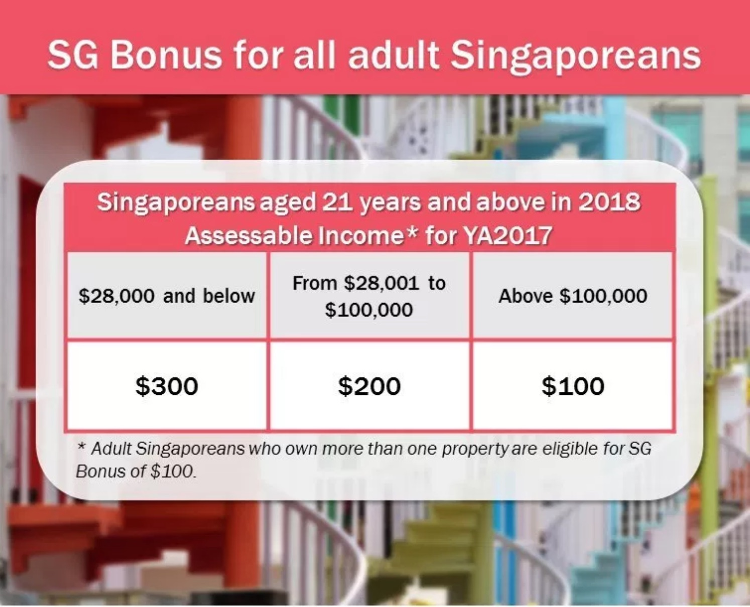
Policy Level Implementation
Implement new policies
Budget Reallocation
Private-public sector collaboration
Adjusting existing comcare budget
inefficient budget spend from other ministries
Eg SG Bonus
Those who still require finances for basic needs
Channel budget surplus towards those who will benefit more from monetary rewards
Notes:
After identifying the target group these are some recommendations for what the govt can do with the findings. First is policywise. Our findings can impact policy decisions on many fronts and across different ministries. But we think that the greatest benefit can be brought about through budget reallocation in a strategic manner towards this target group. We want to be able to improve their financial well-being and happiness without compromising the welfare of others who still require finances for basic needs. So we don’t want to adjust the existing comcare budget but optimize inefficient spending in other ministries.
One of the current measures the Singapore Government has introduced is the SG bonus. This occurs when the Government has a budget surplus for the fiscal year and decides to issue a one-time bonus to all Singaporean adults above 21.
But, not everyone may elicit the same response to this measure. Someone who makes $100,000 a year may not appreciate that extra $100 as much as someone who makes $20,000 a year.
As such, the Singapore Government could channel the funds towards the target “At Risk” group whose happiness can be impacted by more financial measures. This will allow them to give out these bonuses to those who require it more rather than giving it out to everyone.

Slide 25



Ministry and Individual Level Implementation
MSF can can assign dedicated financial planners to help these people plan their finances properly
proper financial planning is required so that these people will be able to eventually achieve the financial freedom required to make their own life choices
1.
2.
3.
Expert financial planners
Solve their specific financial issues
Long term financial planning
Mandatory pro-bono work for financial institutions
Notes:
On a ministry level, the MSF can assign dedicated financial planners to help these people plan their finances properly so that these people will be able to eventually achieve the financial freedom required to make their own life choices. Having a group of financial planners specialized in helping these “At risk” individuals will help them solve their specific financial issues, and better aid them in the long term. These volunteers can be sought from various financial institutions as a form of pro-bono work.

Slide 26
GUI
Illustration
SG finscan
Financial well-being detection System
New citizen Entry
search Existing Entries
Edit Model Features
View at-risk database
Notes:
This is an illustrated example of what the program may look like. We ensured that the design would be user friendly and would not require any analytics or tech background to operate. So let’s enter a new entry

Slide 27



GUI
Illustration
AML Detection System
New Citizen Entry
Read from Scan
Upload PDF
Manual Entry
Financial Well-Being Detection System
Sg finscan
Notes:
We choose to manually enter

Slide 28
GUI
Illustration
New Citizen Entry
Nric number
Full Name
Date of birth
Income amount
Financial aid status
details
Marital status
Education level
Financial knowledge
Financial Well-Being Detection System
Sg finscan
Notes:
Then just fill in the details

Slide 29

GUI
Illustration
Assessing financial well-being
Financial Well-Being Detection System
Sg finscan
Notes:
And the system will load all of the models in the background

Slide 30
GUI
Illustration
Citizen financial well-being report
At
risk
Nric number
Full Name
Date of birth
Income amount
Financial aid status
Financial Well-Being Detection System
Sg finscan
S4562817D
John tan xiao ming
30/41945
$2000 /month
none
Lowest scored features:
Financial Knowledge | Bills repayment | Job security | Mental health | Parents education
2 | 1 | 1 | 1 | 1
Notes:
And give you this report of the person whether they are at risk and their lowest scored features

Slide 31
GUI
Illustration
SG finscan
Financial well-being detection System
New citizen Entry
search Existing Entries
Edit Model Features
View at-risk database
Notes:
You can also search the database

Slide 32
GUI
Illustration
Search existing database
Nric number
Financial Well-Being Detection System
Sg finscan
Search
Notes:
By nric

Slide 33
GUI
Illustration
Citizen financial well-being report: S6527384C
no
risk
Nric number
Full Name
Date of birth
Income amount
Financial aid status
Financial Well-Being Detection System
Sg finscan
S6527384C
Aisha nur hidayati
17/9/1965
$2000 /month
none
Lowest scored features:
Financial Knowledge | Education level | Health insurance | Work/life balance | Parents education
2 | 3 | 2 | 3 | 3
Notes:
And get the same report as before

Slide 34
GUI
Illustration
SG finscan
Financial well-being detection System
New citizen Entry
search Existing Entries
Edit Model Features
View at-risk database
Notes:
lastly you can view the whole database at once

Slide 35
GUI
Illustration
At-risk database
Financial Well-Being Detection System
Sg finscan
NRIC | Full Name | Financial Aid (Y/N) | Date of last Financial Aid | View Full Profile
S4527384C | Harvinder Singh | Y | 2/1/2021 | Click here
S2836427B | Amanda Chan | N | NA | Click here
S6486372G | Lee Wei Jie James | Y | 12/12/2020 | Click here
S7563868T | Tan Jing Yu, Denis | Y | 30/2/2021 | Click here
S4783759L | Valerie Chang | N | NA | Click here
Notes:
So you can see their financial aid status and the date of their last financial aid

Slide 36


Recommendation 3: Feedback Collection for Accuracy and Longevity
1
Before extending help to the identified target persons, policy makers can engage them in a general survey to collect data on their general happiness level
2
After each year of financial aid, evaluation of the usefulness of the solution can be performed by getting these target individuals to gauge their happiness again
To assess the efficacy of our targeted financial intervention
Notes:
Our last recommendation would be feedback collection. So before extending help to the identified target people, policy makers can engage them in a general survey to collect data on their general happiness level. After each year of financial aid, evaluation of the usefulness of the solution can be performed by getting these target individuals to gauge their happiness. This will be useful to assess the efficacy of our targeted financial intervention.

Slide 37
Thank you
Notes:
Our last recommendation would be feedback collection. So before extending help to the identified target people, policy makers can engage them in a general survey to collect data on their general happiness level. After each year of financial aid, evaluation of the usefulness of the solution can be performed by getting these target individuals to gauge their happiness. This will be useful to assess the efficacy of our targeted financial intervention.

